Slide 1
Managing Quality
6

Slide 2
Defining Quality
The totality of features and characteristics of a product or service that bears on its ability to satisfy stated or implied needs
American Society for Quality

Slide 3
Quality Perspective
Quality = Deliverable – Expectations
Customer determines quality

Slide 4
Defining Quality
An operations manager’s objective is to build a total quality management (TQM) system that identifies and satisfies customer needs

Slide 5
Implications of Quality
Company reputation
Perception of new products
Employment practices
Supplier relations
Product liability
Reduce risk
Global implications
Improved ability to compete

Slide 6
Seven Concepts of TQM
Continuous improvement
Six Sigma
Taguchi concepts
Benchmarking
Employee empowerment
Just-in-time (JIT)
Later in the semester
Knowledge of TQM tools

Slide 7
TQM Tools
Tools for Generating Ideas
Check Sheet
Scatter Diagram
Cause-and-Effect Diagram
Tools to Organize the Data
Pareto Chart
Flowchart (Process Diagram)
Tools for Identifying Problems
Histogram
Statistical Process Control Chart

Slide 8
Seven Tools of TQM
(3) Cause-and-Effect Diagram: A tool that identifies process elements (causes) that may effect an outcome
Also called Ishikawa or Fishbone diagrams
Cause
Materials
Methods
Effect
Figure 6.6
Manpower
Machinery
https://www.conceptdraw.com/samples/fishbone-diagram

Slide 9
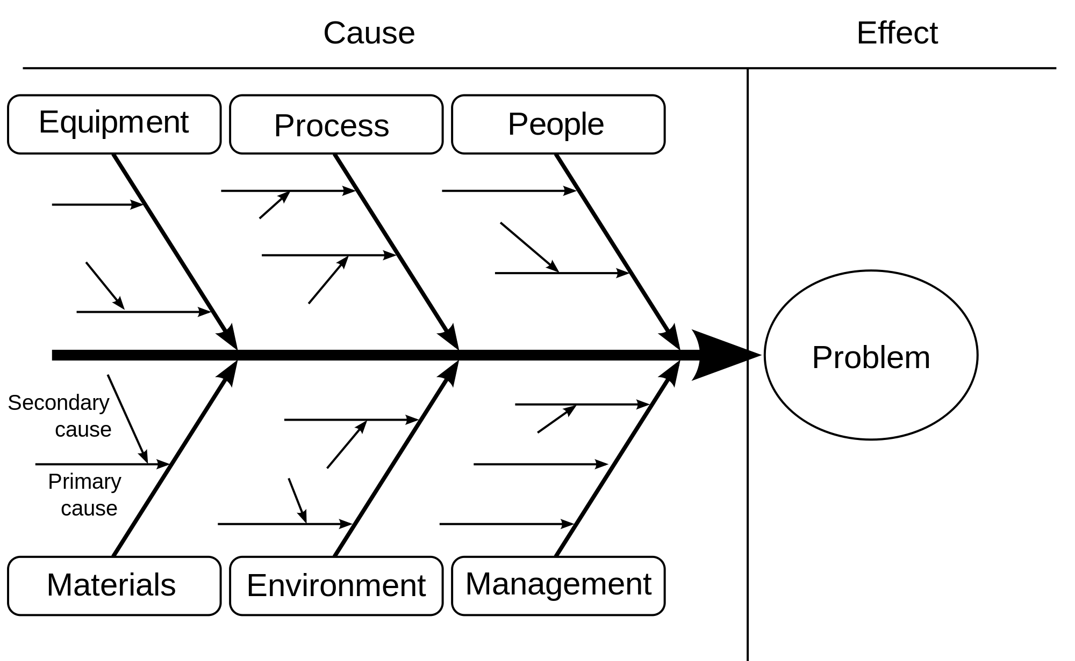
Layout

Slide 10
Main Cause Categories
Manufacturing category examples
Machines/Equipment
Methods
Materials
People
Service category examples
Policies
Procedures
Technical
People

Slide 11
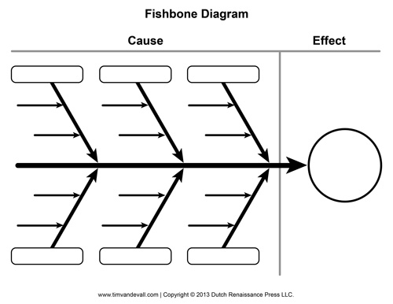
Fishbone Problem
Weather
Category
Category
Snow
Cause
Cause
Cause
Cause
Cause
Late to class
Cause
Cause
Cause
Cause
Cause
Cause
Category
Category
Category

Slide 12
Fishbone Problem
Weather
Vehicle
Student
Snow
Flat tire
Late leaving
Rain
Engine overheat
Poor planning
Late to class
No reserved space
Cell phone died
Other activities
Special Event
Alarm failed
Previous class far
Parking
Technical
Schedule

Slide 13
Seven Tools of TQM
(4) Pareto Chart: A graph to identify and plot problems or defects in descending order of frequency
Frequency
Percent
A B C D E
Figure 6.6

Slide 14
Pareto Charts
Data for October
70 –
60 –
50 –
40 –
30 –
20 –
10 –
0 –
– 100
– 93
– 88
– 72
54
Frequency (number)
Number of occurrences
Cumulative percent
12
4
3
2
Room svc Check-in Pool hours Minibar Misc.
72% 16% 5% 4% 3%
Causes and percent of the total

Slide 15
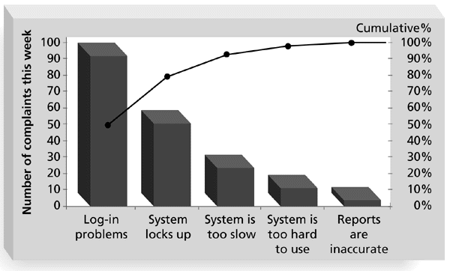
Sample Pareto Chart

Slide 16
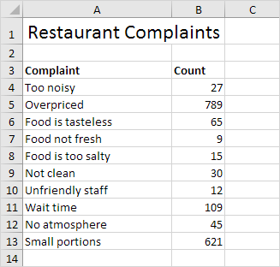
Create a Pareto Chart

Slide 17
Pareto Solution – ASQ Template

Slide 18
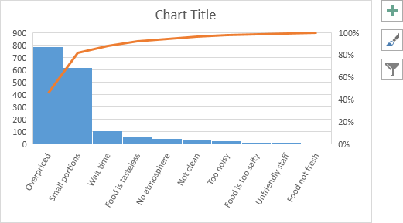
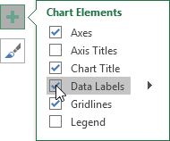
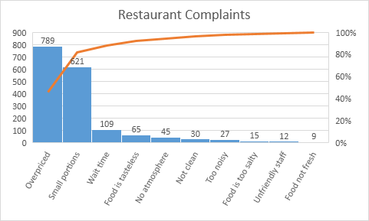

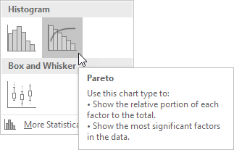
Pareto with Excel
1
4
5
Complaint | Count
Too noisy | 27
Overpriced | 789
Food is tasteless | 65
Food not fresh | 9
Food is too salty | 15
Not clean | 30
Unfriendly staff | 12
Wait time | 109
No atmoshpere | 45
Small portions | 621
2
6
3
For reference only. Use the ASQ Pareto template.

Slide 19
Seven Tools of TQM
(7) Statistical Process Control Chart: A chart with time on the horizontal axis to plot values of a statistic
Upper control limit
Target value
Lower control limit
Time
Figure 6.6

Slide 20
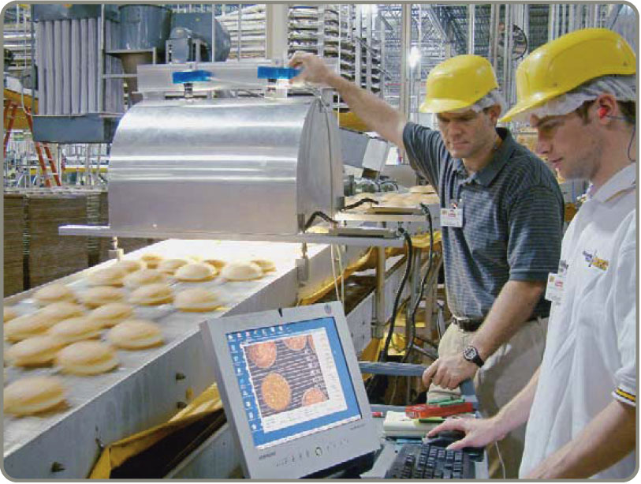
Statistical Process Control (SPC)
Variability is inherent in every process
Natural causes
Random
Assignable causes
Non-random
Provides a statistical signal when assignable causes are present
Detect and eliminate assignable causes of variation
Notes:
Points which might be emphasized include:
- Statistical process control measures the performance of a process, it does not help to identify a particular specimen produced as being “good” or “bad,” in or out of tolerance.
- Statistical process control requires the collection and analysis of data - therefore it is not helpful when total production consists of a small number of units
- While statistical process control can not help identify a “good” or “bad” unit, it can enable one to decide whether or not to accept an entire production lot. If a sample of a production lot contains more than a specified number of defective items, statistical process control can give us a basis for rejecting the entire lot. The issue of rejecting a lot which was actually good can be raised here, but is probably better left to later.

Slide 21
Variability
Random
Caused by nature
Weather
Common causes
Variation in material
Inherent in a process
Sampling protocol
Can be eliminated only through improvements in the system
Non-Random
Special causes
Tampering
New process
Due to identifiable factors
Change in personnel
Part wear
Can be modified through operator or management action

Slide 22
Control Charts

Slide 23
Control Charts
Constructed from historical data, the purpose of control charts is to help distinguish between natural variations and variations due to assignable causes
Notes:
Students should understand both the concepts of natural and assignable variation, and the nature of the efforts required to deal with them.

Slide 24
Control Chart Overview
Control Chart for samples of 9 boxes
Out of control
Variation due to assignable causes
17 = UCL
16 = Mean
Variation due to natural causes
15 = LCL
| | | | | | | | | | | |
1 2 3 4 5 6 7 8 9 10 11 12
Variation due to assignable causes
Out of control
Sample number
***For this class…use Excel to plot control charts

Slide 25
A Process Is in Control If …
No sample points outside limits
Most points near process average
About equal number of points above and below centerline
Points appear randomly distributed

Slide 26
Quality Measures
Variable
Deliverable characteristic that is continuous and can be measured
Falls within an acceptable range
Weight; length
Screen size, diameter of part
Attribute
Deliverable characteristic that can be evaluated with a discrete response
Does not address degree of failure
Good or bad; yes or no
Cell phone turns on, screen broken

Slide 27
Control Chart Type
Variables
Mean chart ( x -Chart )
uses average of a sample
Range chart ( R-Chart )
uses amount of dispersion in a sample
Attributes
p-charts
Uses portion defective in a sample
c-charts
Uses number of defects in an item
Use different charts for each type

Slide 28
Where to Use Control Charts
Process has a tendency to go out of control
Process is particularly harmful and costly if it goes out of control
Examples
At the beginning of a process because it is a waste of time and money to begin production process with bad supplies
Before a costly or irreversible point, after which product is difficult to rework or correct
Before and after assembly or painting operations that might cover defects
Before the outgoing final product or service is delivered

Slide 29
Control Charts for Variable
Range & Mean

Slide 30
Using X-Bar and R-Charts Together
Process average and process variability must be in control
It is possible for samples to have very narrow ranges, but their averages is beyond control limits
It is possible for sample averages to be in control, but ranges might be very large

Slide 31
Mean and Range Charts
(a)
These sampling distributions result in the charts below
(Sampling mean is shifting upward, but range is consistent)
UCL
(x-chart detects shift in central tendency)
x-chart
LCL
UCL
(R-chart does not detect change in mean)
R-chart
LCL
Figure S6.5

Slide 32
Mean and Range Charts
(b)
These sampling distributions result in the charts below
(Sampling mean is constant, but dispersion is increasing)
UCL
(x-chart indicates no change in central tendency)
x-chart
LCL
UCL
(R-chart detects increase in dispersion)
R-chart
LCL
Figure S6.5

Slide 33
Restaurant Control Limits
For salmon filets at Darden Restaurants
11.5 –
11.0 –
10.5 –
x Bar Chart
UCL = 11.524
= – 10.959
LCL = – 10.394
Sample Mean
| | | | | | | | |
1 3 5 7 9 11 13 15 17
0.8 –
0.4 –
0.0 –
Range Chart
UCL = 0.6943
= 0.2125
LCL = 0
Sample Range
| | | | | | | | |
1 3 5 7 9 11 13 15 17

Slide 34
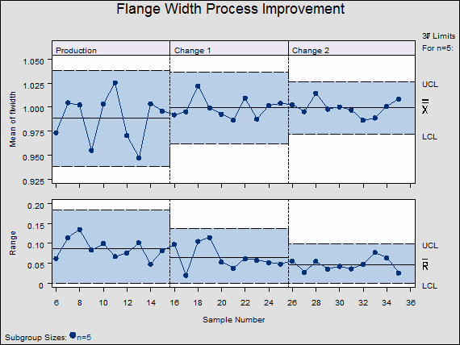
Actual Control Chart Outputs

Slide 35
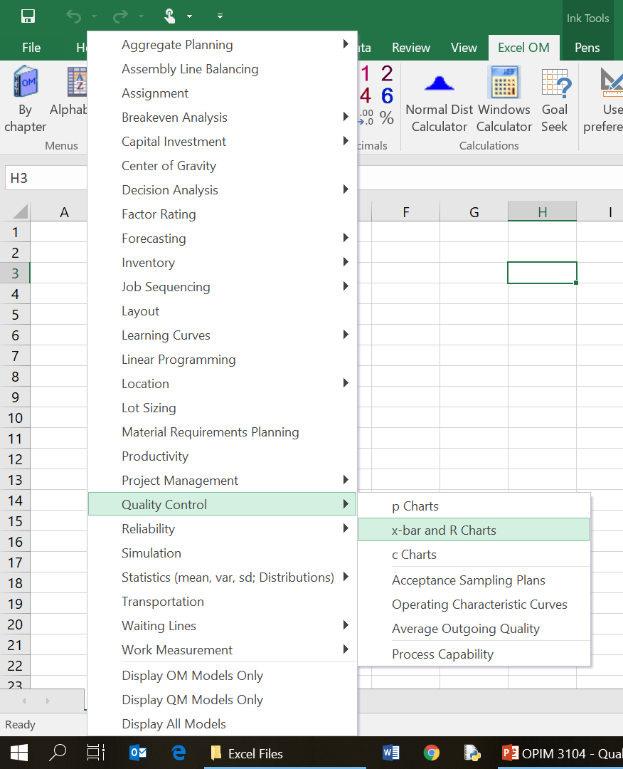
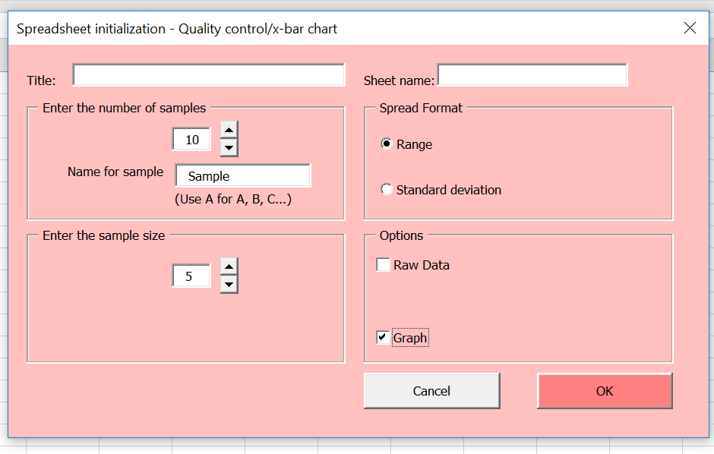
Excel OM Use

Slide 36
X-Bar and R-Chart Example
Number of samples | 10
Sample size | 5
Data
 | Mean | Range
Sample 1 | 22 | 2
Sample 2 | 24 | 3
Sample 3 | 21 | 5
Sample 4 | 19 | 2
Sample 5 | 22 | 3
Sample 6 | 20 | 7
Sample 7 | 21 | 2
Sample 8 | 22 | 1
Sample 9 | 22 | 2
Sample 10 | 24 | 3

Slide 37
X-Bar and R-Chart Example
Quality control/x-bar chart
Number of samples | 10
Sample size | 5
Data
 | Mean | Range
Sample 1 | 4 | 2
Sample 2 | 4 | 3
Sample 3 | 6 | 1
Sample 4 | 7 | 3
Sample 5 | 3 | 1
Sample 6 | 6 | 3
Sample 7 | 3 | 2
Sample 8 | 5 | 1
Sample 9 | 8 | 5
Sample 10 | 2 | 1

Slide 38
Control Charts for Attributes
p-Chart & c-Chart

Slide 39
P-Chart
% Defective

Slide 40
p-Chart for Data Entry
SAMPLE NUMBER | NUMBER OF ERRORS | FRACTION DEFECTIVE | SAMPLE NUMBER | NUMBER OF ERRORS |  |  | FRACTION DEFECTIVE
1 | 6 | .06 | 11 |  | 6 |  | .06
2 | 5 | .05 | 12 |  | 1 |  | .01
3 | 0 | .00 | 13 |  | 8 |  | .08
4 | 1 | .01 | 14 |  | 7 |  | .07
5 | 4 | .04 | 15 |  | 5 |  | .05
6 | 2 | .02 | 16 |  | 4 |  | .04
7 | 5 | .05 | 17 |  | 11 |  | .11
8 | 3 | .03 | 18 |  | 3 |  | .03
9 | 3 | .03 | 19 |  | 0 |  | .00
10 | 2 | .02 | 20 |  | 4 |  | .04
 |  |  |  |  | 80
Cannot have a negative percent defective

Slide 41
p-Chart for Data Entry
.11 –
.10 –
.09 –
.08 –
.07 –
.06 –
.05 –
.04 –
.03 –
.02 –
.01 –
.00 –
UCL_{p} = 0.10
Fraction defective
p = 0.04
| | | | | | | | | |
2 4 6 8 10 12 14 16 18 20
LCL_{p} = 0.00
Sample number

Slide 42
p-Chart for Data Entry
Possible assignable causes present
.11 –
.10 –
.09 –
.08 –
.07 –
.06 –
.05 –
.04 –
.03 –
.02 –
.01 –
.00 –
UCL_{p} = 0.10
Fraction defective
p = 0.04
| | | | | | | | | |
2 4 6 8 10 12 14 16 18 20
LCL_{p} = 0.00
Sample number

Slide 43
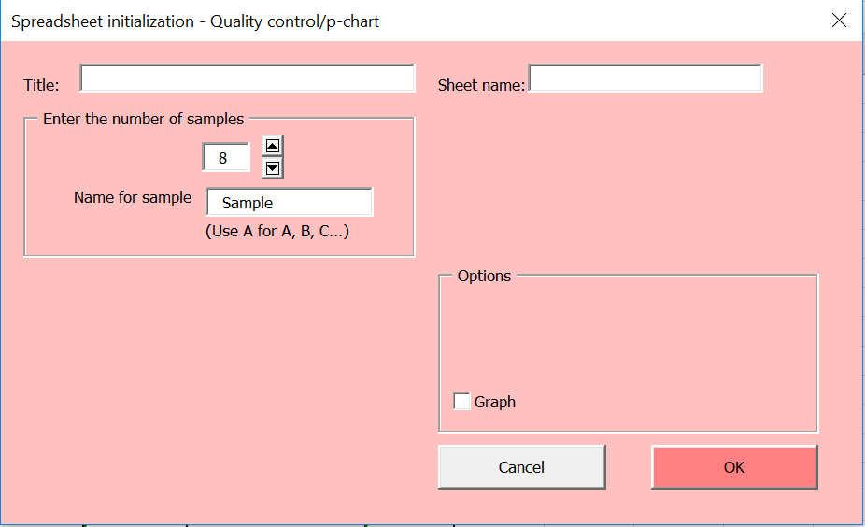
p-Chart Example
Quality control/p-chart
Number of samples | 8
Sample size | 10
Data
 | # Defects
Sample 1 | 2
Sample 2 | 1
Sample 3 | 3
Sample 4 | 2
Sample 5 | 3
Sample 6 | 0
Sample 7 | 5
Sample 8 | 0

Slide 44
C-Chart
# Defects

Slide 45
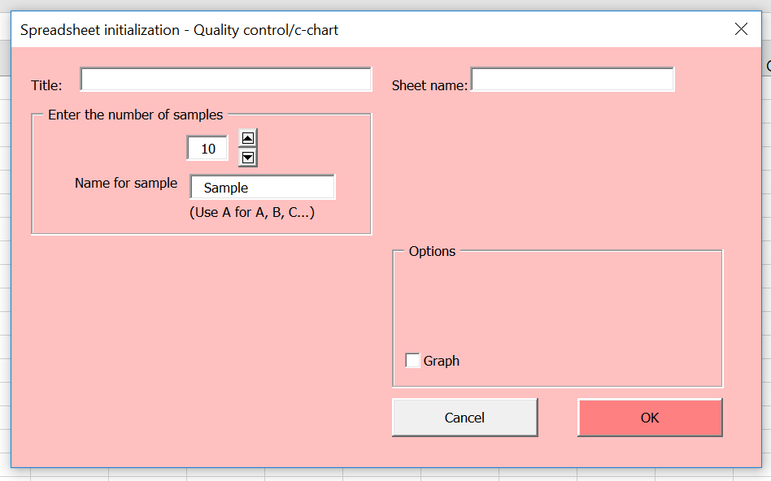
c-Chart Example
Quality control/c-chart
Number of samples | 10
Data
 | # Defects
Sample 1 | 2
Sample 2 | 1
Sample 3 | 2
Sample 4 | 9
Sample 5 | 3
Sample 6 | 2
Sample 7 | 1
Sample 8 | 0
Sample 9 | 3
Sample 10 | 2
Cannot be a
negative number

Slide 46
Which Control Chart to Use
TABLE S6.3 | Helping You Decide Which Control Chart to Use
VARIABLE DATA USING AN x-CHART AND R-CHART
Observations are variables Collect 20 – 25 samples of n = 4, or n = 5, or more, each from a stable process and compute the mean for the x-chart and range for the R-chart Track samples of n observations
Examples
Length
Width
Distance

Slide 47
Which Control Chart to Use
TABLE S6.3 | Helping You Decide Which Control Chart to Use
ATTRIBUTE DATA USING A P-CHART
Observations are attributes that can be categorized and a total number determined We deal with fraction, proportion, or percent defectives There are several samples, with many observations in each
Examples
Cell phones that don’t work compared to those that do
Pages in a report that have errors compared to total pages in the report

Slide 48
Which Control Chart to Use
TABLE S6.3 | Helping You Decide Which Control Chart to Use
ATTRIBUTE DATA USING A C-CHART
Observations are attributes whose defects per unit of output can be counted We deal with the number counted, which is a small part of the possible occurrences Defects may be: number of blemishes on a desk; flaws in a bolt of cloth; crimes in a year; broken seats in a stadium; typos in a chapter of this text; or complaints in a day
Examples
Cracks on a cell phone screen
Number of buttons that don’t work
Number of words per page that are wrong

Slide 49
Process Capability
The natural variation of a process should be small enough to produce products that meet the standards required
A process in statistical control does not necessarily meet the design specifications
Process capability is a measure of the relationship between the natural variation of the process and the design specifications

Slide 50
Process Capability
Tolerances
Design specifications reflecting product requirements
Process capability
Range of natural variability in a process what we measure with control charts

Slide 51
SPC and Process Variability
Lower specification limit
Upper specification limit
(a) Acceptance sampling (Some bad units accepted; the "lot" is good or bad)
(b) Statistical process control (Keep the process "in control")
(c) C_{pk} > 1 (Design a process that is in within specification)
Process mean, μ
Figure S6.10
Notes:
This may be a good time to stress that an overall goal of statistical process control is to “do it better,” i.e., improve over time.

Slide 52
Additional Info
To assist with homework

Slide 53
Total Quality Management (TQM)
Encompasses entire organization from supplier to customer
Stresses a commitment by management to have a continuing companywide drive toward excellence in all aspects of products and services that are important to the customer

Slide 54
Continuous Improvement
Never-ending process of continuous improvement
Covers people, equipment, suppliers, materials, procedures
Every operation can be improved

Slide 55
Six Sigma
Originally developed by Motorola, adopted and enhanced by Honeywell and GE
Highly structured approach to process improvement
A strategy
A discipline – DMAIC
A set of 7 tools

Slide 56
Costs of Quality
Total Cost
Total Cost
External Failure
Internal Failure
Prevention
Appraisal
Quality Improvement

Slide 57
Seven Tools of TQM
(1) Check Sheet: An organized method of recording data
Hour
Defect 1 2 3 4 5 6 7 8
A
B
C
/
/
/
/
/
/
/
/
/
/
/
/
/
/
/
/
/
/
/
/
/
/
/
/
/
/
/
/
/
/
Figure 6.6

Slide 58
Seven Tools of TQM
(2) Scatter Diagram: A graph of the value of one variable vs. another variable
Productivity
Absenteeism
Figure 6.6

Slide 59
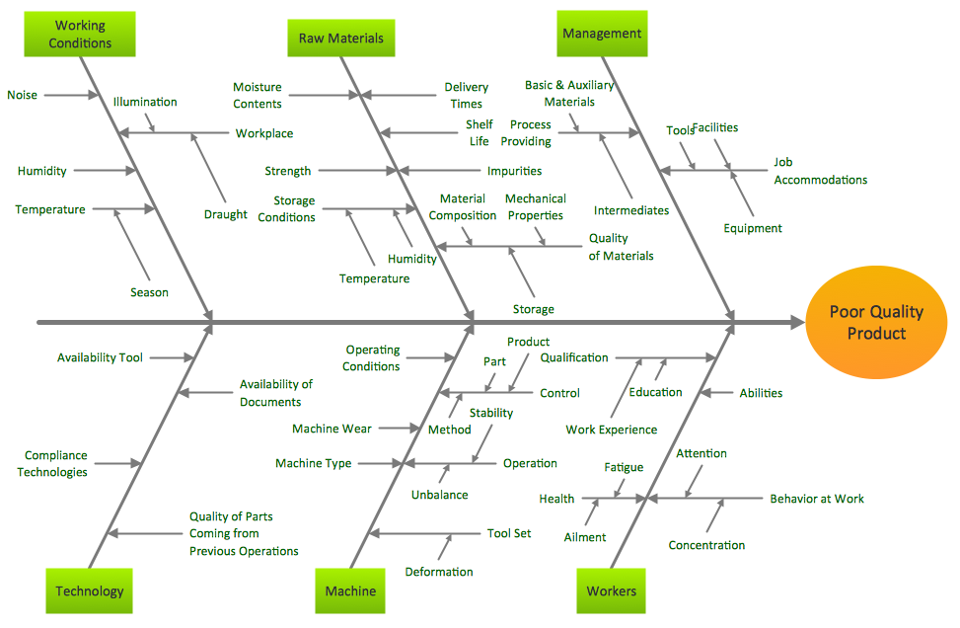
Causes of Low Quality
https://www.conceptdraw.com/samples/fishbone-diagram

Slide 60
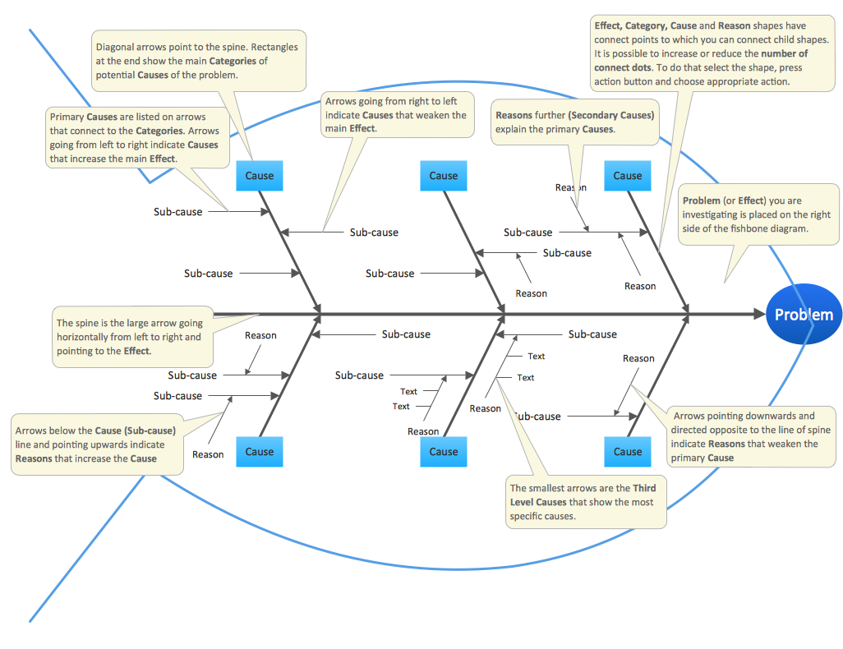
Fishbone Details
https://www.conceptdraw.com/samples/fishbone-diagram

Slide 61
Seven Tools of TQM
(5) Flowchart (Process Diagram): A chart that describes the steps in a process
Figure 6.6

Slide 62
Flow Charts
MRI Flowchart
Physician schedules MRI
Patient taken to MRI
Patient signs in
Patient is prepped
Technician carries out MRI
Technician inspects film
If unsatisfactory, repeat
Patient taken back to room
MRI read by radiologist
MRI report transferred to physician
Patient and physician discuss
8
80%
1
2
3
4
5
6
7
11
9
10
20%

Slide 63
Seven Tools of TQM
(6) Histogram: A distribution showing the frequency of occurrences of a variable
Distribution
Frequency
Repair time (minutes)
Figure 6.6

Slide 64
Statistical Process Control (SPC)

Slide 65
SPC Outline
Basics of Statistical Process Control
Control Charts
Control Charts for Attributes
Control Charts for Variables
SPC with Excel
Process Capability

Slide 66
SPC in TQM
SPC
Tool for identifying problems and make improvements
Contributes to the TQM goal of continuous improvements

Slide 67
Statistical Process Control (SPC)
The objective of a process control system is to provide a statistical signal when assignable causes of variation are present

Slide 68
Statistical Process Control (SPC)
Uses statistics and control charts to tell when to take corrective action
Drives process improvement
Four key steps
Measure the process
When a change is indicated, find the assignable cause
Eliminate or incorporate the cause
Restart the revised process

Slide 69
SPC Sampling
To measure the process, we take samples and analyze the sample statistics following these steps
(a) Samples of the product, say five boxes of cereal taken off the filling machine line, vary from each other in weight
Each rectangle represents one sample of five boxes of cereal
#
#
#
#
#
Frequency
#
#
#
#
#
#
#
#
#
#
#
#
#
#
#
#
#
#
#
#
#
Weight
Figure S6.1

Slide 70
SPC Sampling
To measure the process, we take samples and analyze the sample statistics following these steps
The solid line represents the distribution
(b) After enough samples are taken from a stable process, they form a pattern called a distribution
Frequency
Weight
Figure S6.1

Slide 71
SPC Sampling
To measure the process, we take samples and analyze the sample statistics following these steps
(c) There are many types of distributions, including the normal (bell-shaped) distribution, but distributions do differ in terms of central tendency (mean), standard deviation or variance, and shape
Figure S6.1
Central tendency
Variation
Shape
Frequency
Weight
Weight
Weight

Slide 72
SPC Sampling
To measure the process, we take samples and analyze the sample statistics following these steps
(d) If only natural causes of variation are present, the output of a process forms a distribution that is stable over time and is predictable
Prediction
Frequency
Time
Weight
Figure S6.1

Slide 73
SPC Sampling
To measure the process, we take samples and analyze the sample statistics following these steps
?
?
?
(e) If assignable causes are present, the process output is not stable over time and is not predicable
?
?
?
?
?
?
?
?
?
?
?
?
?
?
?
?
Prediction
Frequency
Time
Weight
Figure S6.1

Slide 74
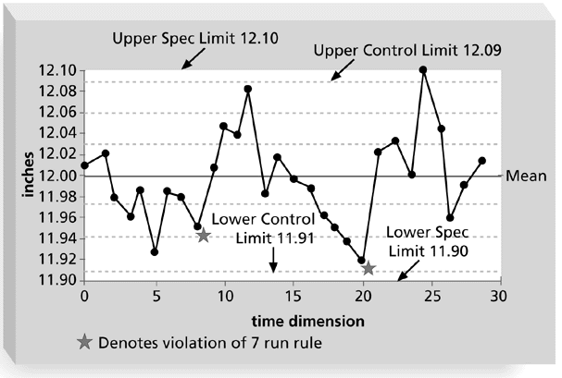
Sample Quality Control Chart

Slide 75
Process Control Chart
Out of control
Upper
control
limit
Process
average
Lower
control
limit
1
2
3
4
5
6
7
8
9
10
Sample number

Slide 76
x- bar Chart Example (cont.)
5.10 –
5.08 –
5.06 –
5.04 –
5.02 –
5.00 –
4.98 –
4.96 –
4.94 –
4.92 –
UCL = 5.08
=
Mean
x = 5.01
LCL = 4.94
|
1
|
2
|
3
|
4
|
5
|
6
|
7
|
8
|
9
|
10
Sample number

Slide 77
R-Chart Example (cont.)
0.28 –
0.24 –
0.20 –
0.16 –
0.12 –
0.08 –
0.04 –
0 –
UCL = 0.243
R = 0.115
Range
LCL = 0
|
1
|
2
|
3
|
4
|
5
|
6
|
7
|
8
|
9
|
10
Sample number

Slide 78
p-Chart Example (cont.)
0.20
0.18
UCL = 0.190
0.16
0.14
0.12
Proportion defective
p = 0.10
0.10
0.08
0.06
0.04
0.02
LCL = 0.010
2
4
6
8
10
12
14
16
18
20
Sample number

Slide 79
c-Chart (cont.)
24
UCL = 23.35
21
18
c = 12.67
15
Number of defects
12
9
6
3
LCL = 1.99
2
4
6
8
10
12
14
16
Sample number

Slide 80
Process Capability
Design Specifications
(a) Natural variation exceeds design specifications; process is not capable of meeting specifications all the time.
Process
Design Specifications
(b) Design specifications and natural variation the same; process is capable of meeting specifications most of the time.
Process

Slide 81
Process Capability (cont.)
Design Specifications
(c) Design specifications greater than natural variation; process is capable of always conforming to specifications.
Process
Design Specifications
(d) Specifications greater than natural variation, but process off center; capable but some output will not meet upper specification.
Process

